Slide 1
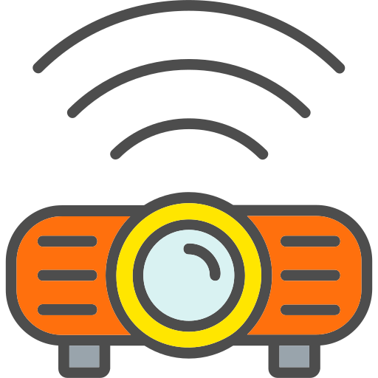


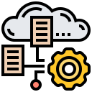
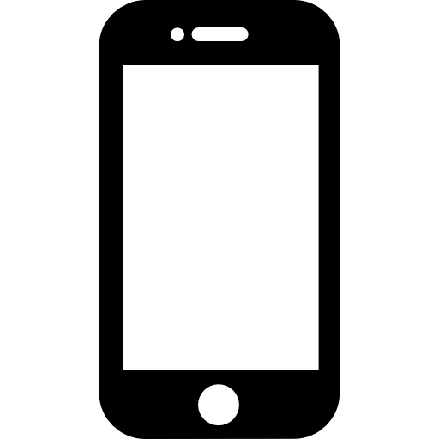
STEP 2
STEP 4
The data from the IoT Module is uploaded into the IoT cloud for further operation
The raw data is collected from the soil using the various sensors
The recommended crop is shown on the device of the user
Uploading of data into the IoT cloud
Crop Recommendation
Data Collection
Sending of data to IoT Module
Analysis of the data
The data uploaded into the IoT cloud is now analyzed for predicting the crop
The collected raw data is now uploaded into the IoT Module
STEP 1
STEP 3
STEP 5

